Slide 1
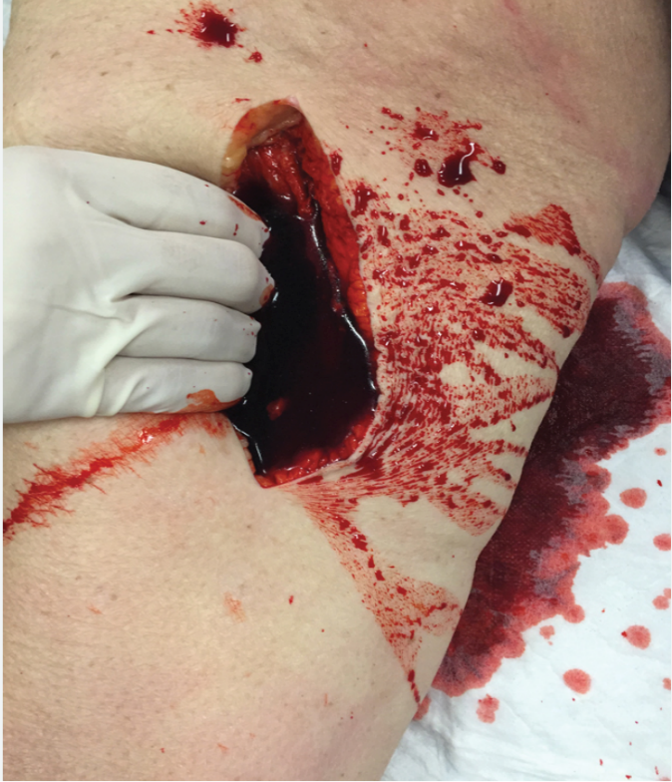
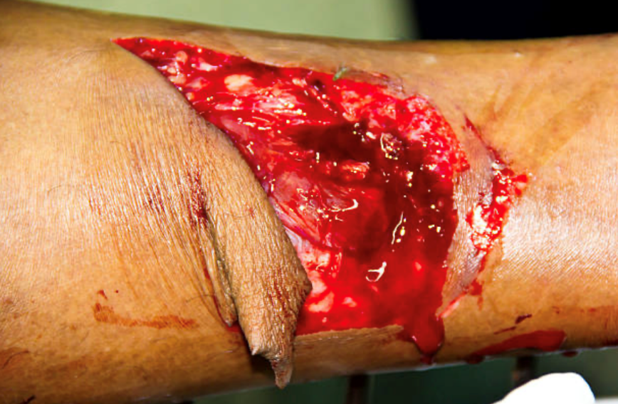
1.2 Accident Management (Bleeding)
SK-DIV-PPT-005
BLEEDING
OPEN WOUNDS
Do not remove the object – will cause haemorrhage by releasing pressure on severed blood vessels and lead to further damage
Expose wound area by cutting clothing
Control bleeding with hand
Stabilise object with bulky dressing
Transport promptly but carefully, may need to modify object. Exemption?

Slide 2
1.1 Accident Management (Bleeding)
SK-DIV-PPT-005
BLEEDING
CLOSED WOUNDS
Unlike open wounds, closed wounds do not break the skin's surface, which means there is no direct exposure to the external environment. Despite the lack of visible disruption, closed wounds can still be significant and require careful assessment and management to prevent complications and promote recovery.
Slips, trips and falls most commonly
Pain in bone or joint, injury in surrounding tissue showing swelling and bruising i.e.
Contusions - Trauma or tearing of muscles or tendons
Strains - Stretching or tearing of muscles or tendons
Sprains - Stretching or tearing of ligaments
500-1500ML – Femur fracture

Slide 3
1.2 Accident Management (Bleeding)
SK-DIV-PPT-005
BLEEDING
HEALING
Coagulation: begins immediately
Inflammation:
Swelling-build up of fluid in tissue
Redness-increased blood flow
Pain- action of bradykinin and prostaglandins on local nerve tissue
Heat- increased blood flow
Remodeling: scar tissue formation
Healing is influenced my numerous factors:
Local factors-02 supply, infection
Regional factors- inadequate blood supply
Nutrition
Illness
radiation

Slide 4
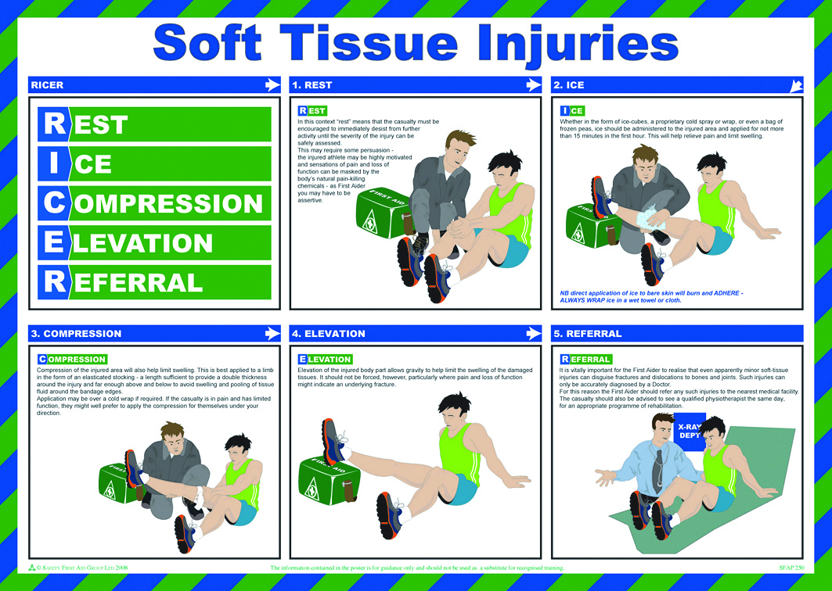
1.3 Accident Management (Soft Tissue Injuries)
SK-DIV-PPT-005
TREATMENT OF SOFT TISSUE INJURIES
RICER
Rest- prevent further damage
Ice- decreases swelling, bleeding by constricting blood vessels therefore decrease pain and spasm. 24-72hrs post
Compression- direct pressure decreases bleeding
Elevation- reduces internal bleeding
Referral/ Diagnosis
Also think of splinting and anti inflammatories

Slide 5
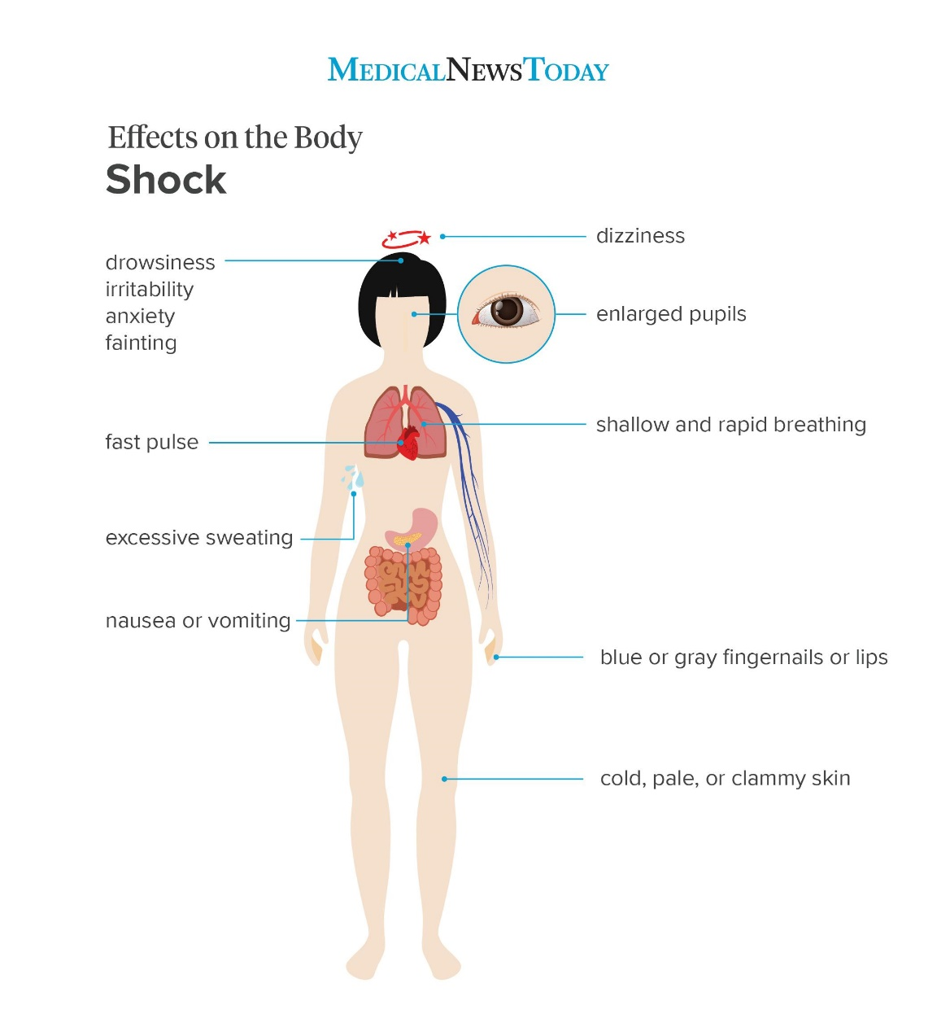
1.4 Accident Management (Shock)
SK-DIV-PPT-005
SHOCK
SIGNS AND SYMPTOMS:
Weakness
Feeling of impending doom
Dizziness
Nausea
Thirst
Coolness
BP decrease
Rapid/weak pulse
Shallow respirations
Pale skin
Sweating
Shaking
Dilated pupils, dull eyes

Slide 6
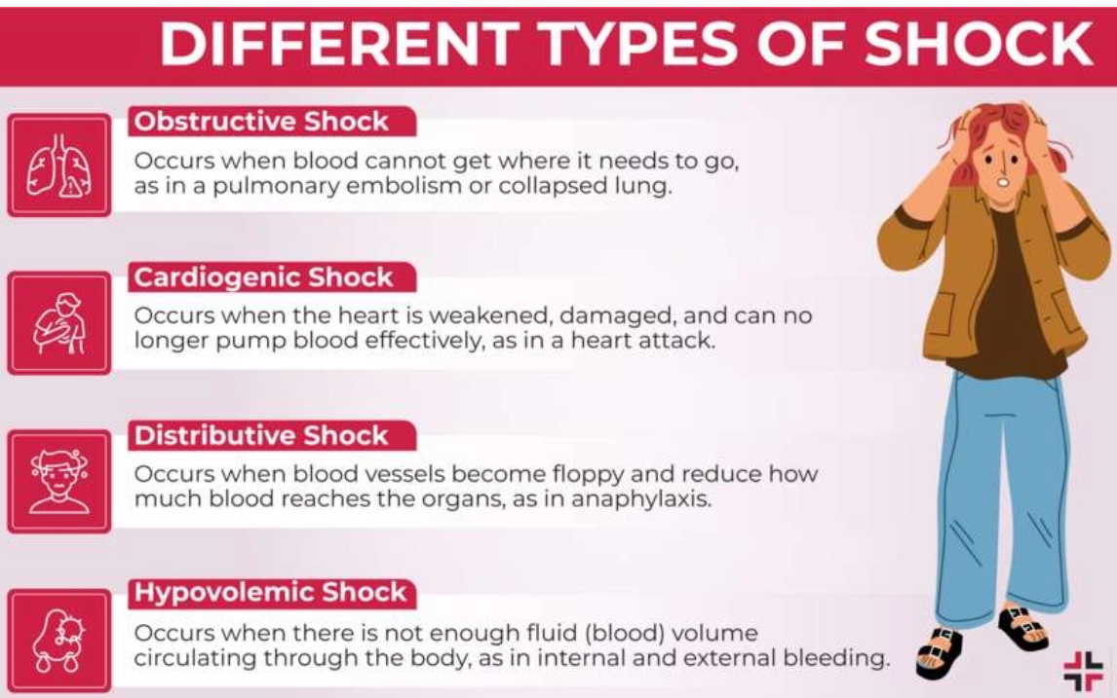
1.4 Accident Management (Shock)
SK-DIV-PPT-005
SHOCK
Hypovolemic
Loss of blood, leads to insufficient blood supply to the body
Respiratory
Insufficient oxygen in the blood and thus the body
Neurological
Loss of control of the nervous system, leads to loss of control of the blood vessels which become dilated
Psychogenic
Fainting, sudden dilation of blood vessels from external stimuli, blood supply to brain momentarily interrupted
Cardiogenic
Inadequate heart function, circulation impaired
Septic
Severe infection releases toxins into the blood vessels causing vasodilation and loss of plasma through vessels walls
Metabolic
Loss of bodily fluids and changes in chemistry (e.g. heat stroke)
Anaphylactic
Contact with something which one Is extremely allergic to.

Slide 7
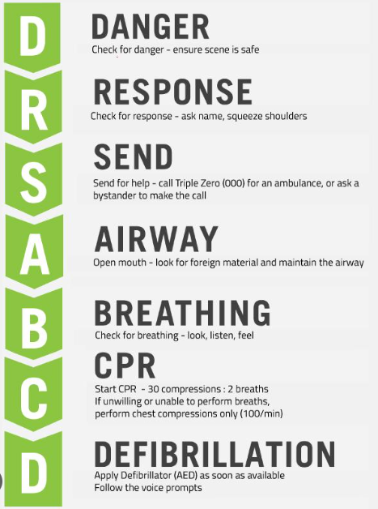
1.4 Accident Management (Shock)
SK-DIV-PPT-005
SHOCK
TREATMENT:
DRSABCD
Treat cause of shock (i.e, control bleeding, splint fractures)
Position patient supine with legs slightly raised
Provide Oxygen
Keep patient warm
Nil By Mouth (NBM)
Document all treatment with times to handover.

Slide 8
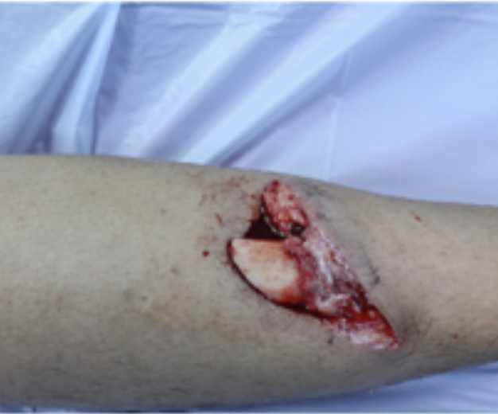
1.5 Accident Management (Fractures)
SK-DIV-PPT-005
FRACTURES
CLOSED OR SIMPLE
Overlying skin unbroken
COMPOUND
Overlying skin broken with wound over fracture site
COMPLICATED
Fractured bone affecting nearby organs
DISLOCATION
Where sudden impact injures a joint. Do not attempt to re-align as may trap nerves or blood vessels causing further damage.

Slide 9
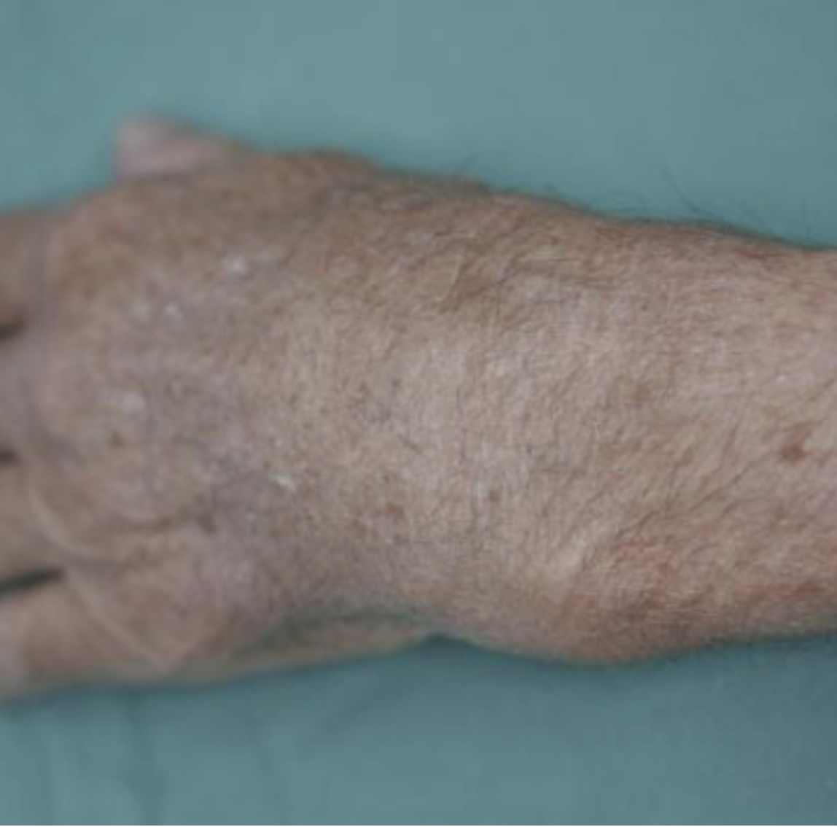
1.5 Accident Management (Fractures)
SK-DIV-PPT-005
FRACTURES
CAUSED BY
Direct force- break at site of impact
Abnormal muscular contraction-through a fall or car accident
Indirect force-bone broken at site distant from point of impact
SIGNS AND SYMPTOMS
Pain at or near site
Deformity
Unnatural movement
Crepitus
Loss or reduction of movement
Swelling
irregularity

Slide 10
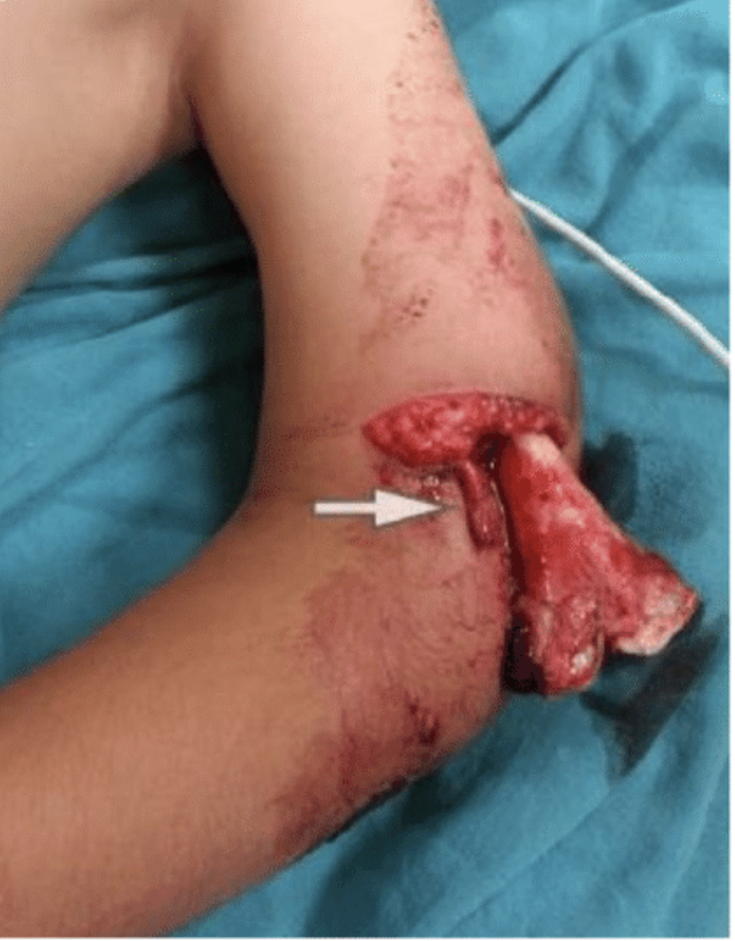
1.5 Accident Management (Fractures)
SK-DIV-PPT-005
FRACTURES
MANAGEMENT/ TREATMENT
Primary survey DRSABCD
Prevent movement at fracture site
Splint
Elevate if possible
Treat for shock
Do not realign unless impossible to move
Medical aid

Slide 11
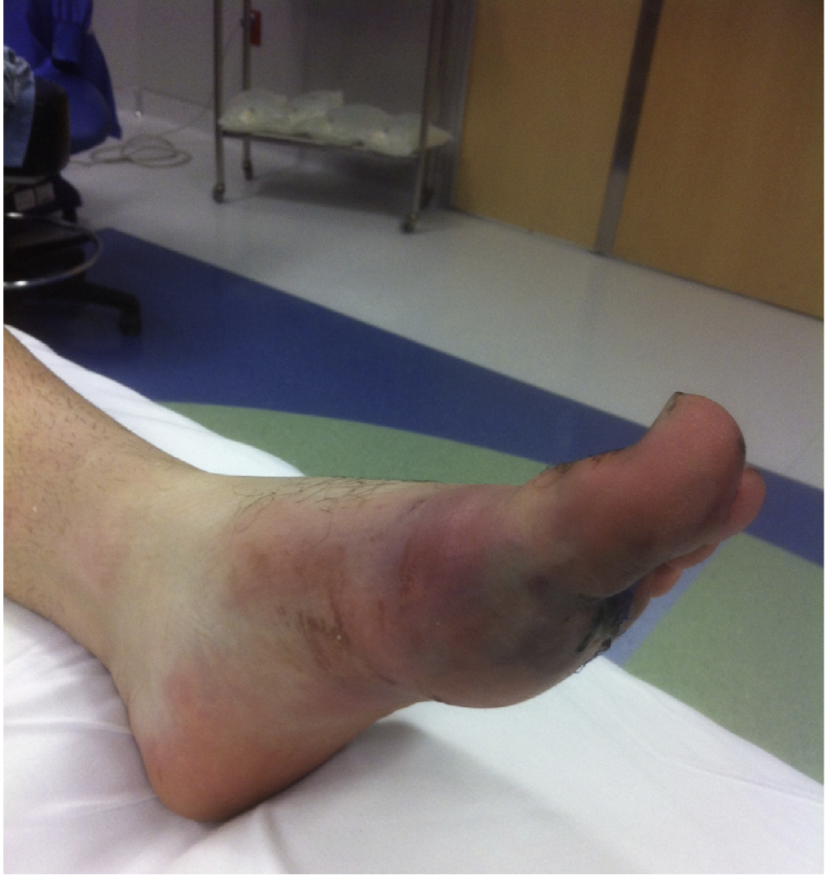
1.6 Accident Management (Crush Injuries)
SK-DIV-PPT-005
CRUSH INJURIES
Usually occurring due to mechanical failures and natural disasters, develops into crush syndrome after 4hrs
Crushing forces should be removed as soon as possible
Where crushing forces are left for an extended period, it can lead to shock and kidney failure from chemical changes in the blood
Medical assistance is required urgently
Muscles can survive without oxygen for 2hrs with no long-term effects due to having their own store of energy (ATP and Myoglobin)
Rhabdomyolysis-This is caused by the breakdown of damaged skeletal tissue. It releases muscle cell contents, including proteins into the blood stream this can lead to kidney damage, renal failure and cardiac arrest, oedema of the crushed limb and hypovolemic shock
Extent of complications depend on muscle mass, time crushed, time since rescued and hydration status (therefore fluid resus is important)

Slide 12
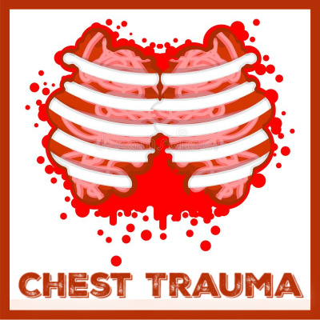
1.7 Accident Management (Chest Trauma)
SK-DIV-PPT-005
CHEST TRAUMA
ANATOMY AND PHYSIOLOGY
Each lung is surrounded by 2 layers of membrane called pleura. Each membrane is a pleural cavity, containing a thin layer of “serous fluid” which aids in movement
If the outer layer is damaged through a penetrating injury air can be sucked from outside into the pleural cavity causing a collapse Pneumothorax
If air continues to be sucked in but cannot escape, pressure can build up- tension pneumothorax, causing difficulty for lung and heart function
CONTUSIONS
Can be associated with serious injuries such as fractures and or internal bleeding, need is then to provide airway protection, Oxygen, IV’s and monitor
HAEMATOMAS
Can develop in organs, there are 2 types, intermuscular and intramuscular. Welt like formations hard to touch, forms in a sack which keeps internal bleeding to a minimum and usually dissolves. If it doesn’t disappear, surgery may be required.

Slide 13
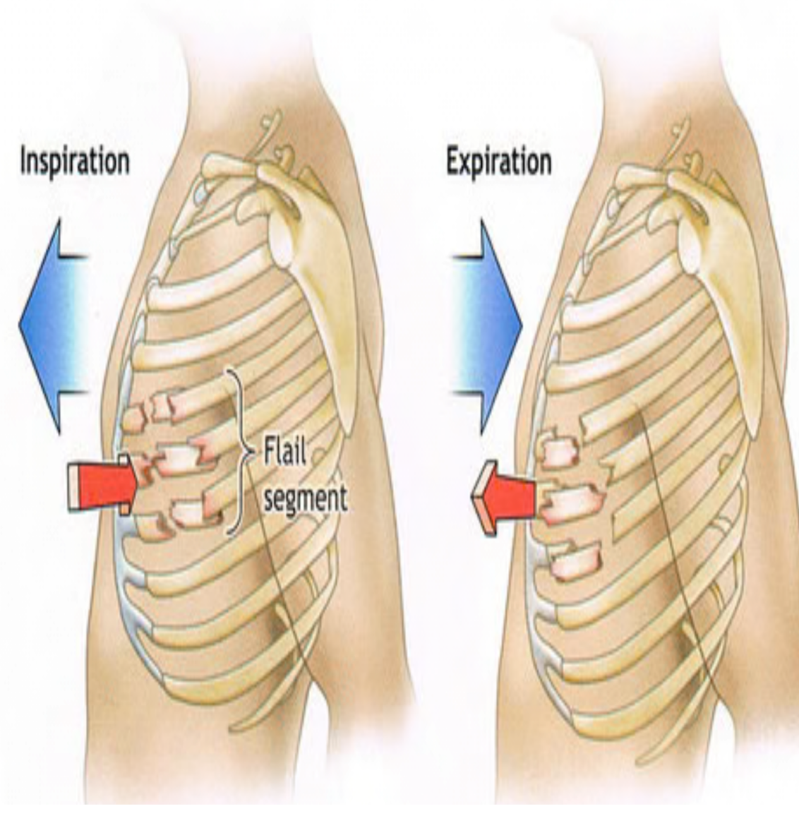
1.7 Accident Management (Chest Trauma)
SK-DIV-PPT-005
CHEST FLAIL
This is a condition where ribs become fractured in several places creating floating section
It happens when a segment of the chest wall breaks under the pressure and becomes detached from the chest wall.
The flail segment moves inward during inspiration(instead of outward) and outward during expiration(instead of inward. Paradoxical movement.
SIGNS AND SYMPTOMS
Severe difficulty breathing
Shallow painful breathing
S and S of fracture
Paradoxical chest movement

Slide 14
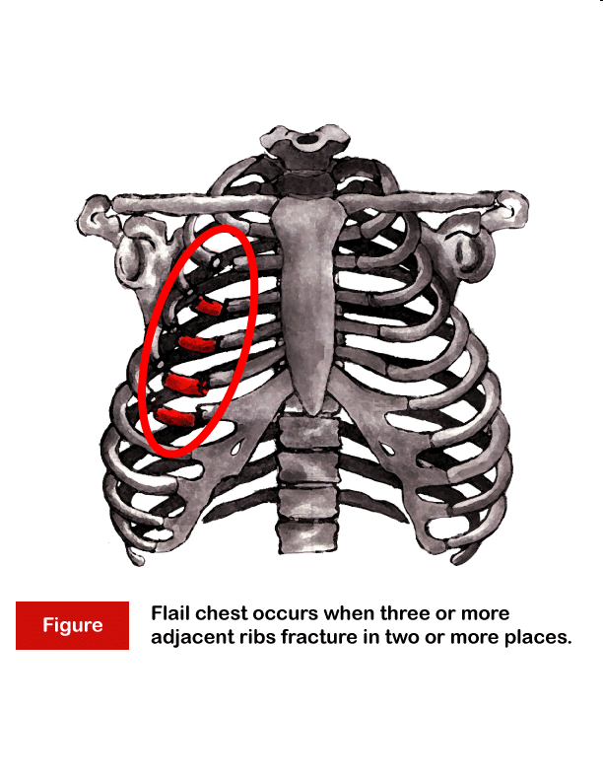
1.7 Accident Management (Chest Trauma)
SK-DIV-PPT-005
FLAIL CHEST
This is life threatening and over 50% of people with this injury die.
TREATMENT
Large amounts of padding and arm in sling
Analgesia NSAID’s(Non-steriodal Anti-Inflammatory Drugs (not narcotics))
Oxygen

Slide 15
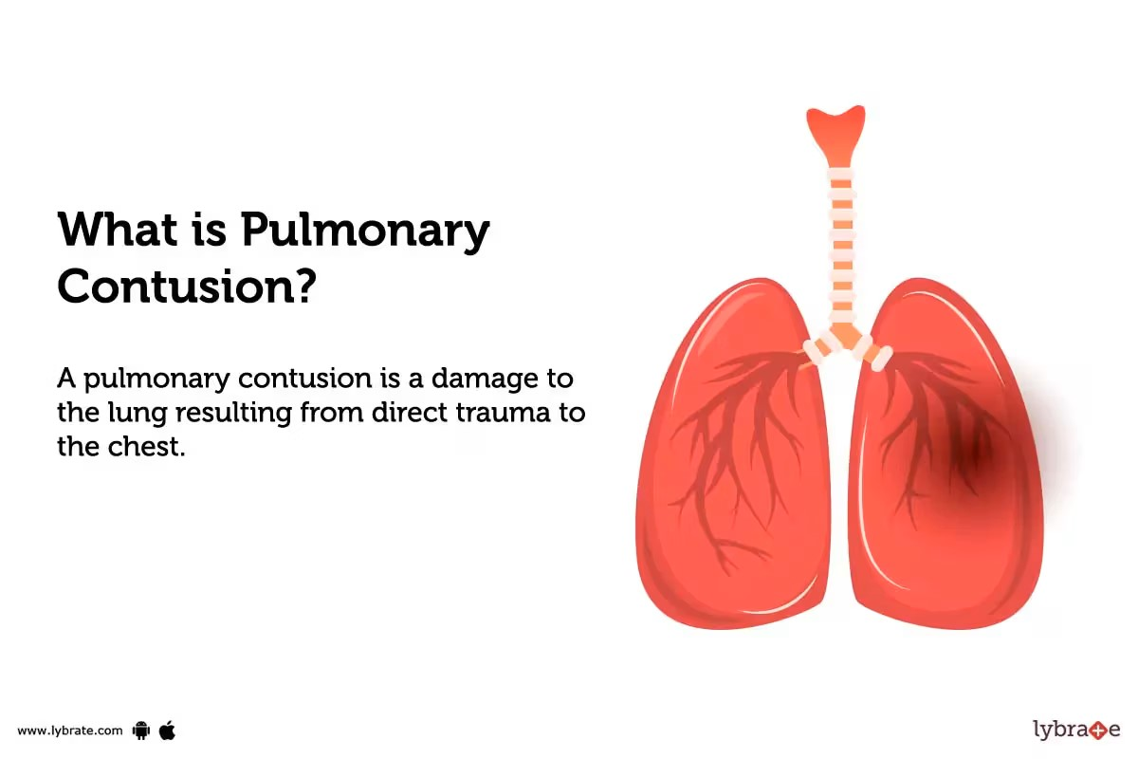
1.7 Accident Management (Chest Trauma)
SK-DIV-PPT-005
CONTUSIONS
Can be associated with serious injuries such as fractures and/or internal bleeding.
Need to provide airway protection.
Hematomas: Can also develop in organs.
There are two types: Intermuscular and intramuscular.
They are welt like formations that are hard to the touch. Form a sack which keeps internal bleeding to a minimum and usually dissolve. If it doesn’t disappear, surgery may be required to remove it.

